Slide 1
Proposal to support Open Source 5G Core as an OASIS Open Project
Who is OASIS? (slides 2-4)
What is an Open Project? (slides 5-10)
How are governance and licensing handled? (slides 11-14)
How are Open Projects funded? (slides 15-17)
Resources (slides 18-22)

Slide 2
Who is OASIS?

Slide 3
OASIS: Where open source and open standards thrive
6
CONTINENTS
70+
COMMUNITIES
150+
STANDARDS
2000+
PARTICIPANTS
Nonprofit, 501(c)(6), member-driven organization
Built on openness, inclusivity, and innovation
Federation of autonomous working groups
Member of European Multi-Stakeholder Platform on ICT Standardization→ EU allows OASIS specs to be referenced in public procurement.
Liaison relationships offer path to de jure standardization: ISO, IEC (JTC 1), ITU
ANSI-certified process
Notes:
OASIS is a nonprofit, international, member-driven organization founded in 1993. We provide support for open standards and open source development.
We’re the home of a lot of standards that you’re probably familiar with—SAML, OpenDocument Format…--and may others that you may not have but that touch your lives, like the Common Alerting Protocol that’s used for Amber alerts on missing children. We have a broad scope of work, cybersecurity, blockchain, privacy, sharing economy, cryptography, cloud computing, augmented reality, emergency management, legal…
We understand how transparent, fair community development gets done. We know how to support it, we know what it takes to get work adopted.
We try to be as flexible as possible in serving the varying needs of different communities. Groups at OASIS work autonomously, setting their own goals, making their own decisions… but openness, transparency, inclusivity…those are things we stand firm on.
Our process is recognized by the de jure bodies and much of our work has gone on to be published by ISO, IEC, and ITU.
-----------------
https://www.oasis-open.org/

Slide 4








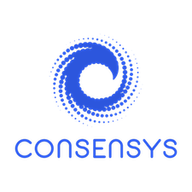


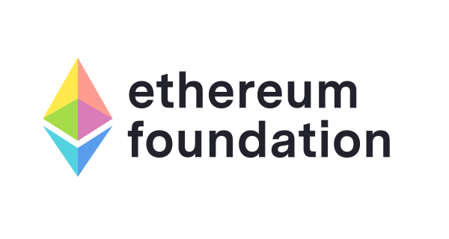
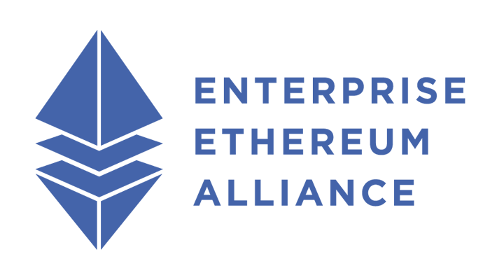



















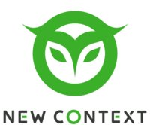


















OASIS community spans industries
See full roster: www.oasis-open.org/member-roster
Notes:
Our 2000+ participants include large, multinational companies (SAP, MITRE, AT&T, Cisco, Ericsson, Huawei, Nokia, VMware, Google, Amazon, IBM…), government agencies, academic institutions, SMEs, and consultants from around the world.

Slide 5
OASIS → de jure
OASIS Standard | Also Approved As:
Advanced Message Queuing Protocol (AMQP) | ISO/IEC 19464
Authentication Step-Up Protocol and Metadata | ITU-T X.1276
Common Alerting Protocol (CAP) | ITU-T Rec. X.1303
Computer Graphics Metafile (WebCGM) | W3C WebCGM
ebXML Collaborative Partner Profile Agreement | ISO 15000-1
ebXML Messaging Service Specification | ISO 15000-2
ebXML Registry Information Model | ISO 15000-3
ebXML Registry Services Specification | ISO 15000-4
MQTT | ISO/IEC 20922
OData | ISO/IEC 20802-1
OData JSON Format | ISO/IEC 20802-2
OpenDocument Format (ODF) | ISO/IEC 26300
Security Assertion Markup Language (SAML) | ITU-T Rec. X.1141
Universal Business Language (UBL) | ISO/IEC 19845
Extensible Access Control Markup Language (XACML) | ITU-T Rec. X.1144
XLIFF | ISO/DIS 21720

Slide 6
What is an Open Project?

Slide 7
OASIS Open Projects support shared community development of code, APIs, standards, reference implementations… in one place, under open source licenses with a path to recognition in international policy and procurement.
Notes:
Open Projects is the first-of-its-kind program that creates a more transparent and collaborative future for open source and standards development. Open Projects gives communities the power to develop what they choose--APIs, code, specifications, reference implementations, guidelines-- in one place, under open source licenses, with a path to recognition in global policy and procurement.

Slide 8
Open Projects lets you
Engage open source community in distributed development while ensuring work stays on-track
Use vetted IP policy and open source licenses
Work under supported, streamlined process.
Submit work to ISO, IEC, ITU and/or EU for international recognition via PAS submitter status.
Focus on your technical goals while OASIS staff takes care of financial, legal, and technical administration and marketing
Leverage OASIS global reputation, 2000+ member base, and experience running standards and open source projects
Notes:
OASIS developed the Open Projects program because we realized:
Governments hesitate to recognize and reference open source artifacts in public policy and procurement unless they know the open source work is the product of a transparent process with responsible IP management.
Groups don’t want to develop standards in one place and open source code and APIs in another place.
The lines between open source and open standards are blurring.
Organizations are willing to underwrite foundation costs in order to encourage technical input from developers who are not dues-payers.
The open source community would welcome an alternative to the current hosting options.
Open Projects gives groups more control and streamlined governance. It provides all the process a community needs--and not a bit more--so groups can accomplish great things fast.

Slide 9




Carol Geyer Chief Development Officer
What can an Open Project do?
Utilize the same tools and infrastructure to develop open source and standards.
Leverage a wide network of experts and stakeholders to inform strategic decisions.
Iterate quickly while taking advantage of thorough, best-practices process.
Attract a bigger community of contributors with clear, open, transparent governance.

Slide 10
What you get (and don’t get) with Open Projects
High cost of a Foundation Stakeholder governance
Legal headaches, IPR obstacles Industry-vetted IP licenses, support
Fractured development efforts Unified community
Ignored by government procurement International recognition
Opaque rules and processes Transparent tools, support, best practices

Slide 11
What core services does OASIS provide?
Legal entity, management of trademarks and copyrights
Contributor License Agreement administration
Collaboration tool set: GitHub org, mailing group, calendar, roster, ballot, asynchronous chat, video meetings…
OASIS Standards process submission management
Submission of approved deliverables to ISO, IEC, ITU via OASIS liaison
Community management support
Assistance in writing charter, Code of Conduct, other policies
Governance administration and support
Initial set-up of project assets such as website design, hosting, site maintenance, collateral and logo design
Press, promotion & outreach to attract developers and sponsors
Meeting planning and coordination
Free public access to deliverables in perpetuity
Notes:
OASIS works hard to deliver valuable benefits.
You don’t need to become a legal expert—we have the licensing and IP commitment issues covered so you—and everyone else—knows what’s developed is going to be safe for implementation.
Code development, version control, release management and issue tracking are supported using Git, as managed by GitHub. You may request as many new repositories as is needed under the OASIS Github organization, transition your existing code and workflow tools to the OASIS organization, or continue to use your existing org.
Your work will be freely available to the public in perpetuity.
We help with all the promotional needs—web site, logo, press relations.
The last bullet is particularly important in my view. OASIS is very good at building support and growing communities.

Slide 12
How are governance and IP handled?

Slide 13
Project Governing Board
Sponsors & TSC rep
Technical Steering Committee
Marketing Committee
Other Group(s)
Community Members (Merit)
Repo #1
Repo #2
Other Contributions
Required
Optional
Open Project Governance
Notes:
OASIS Rules requires all Open Projects to have a Project Governing Board, a Technical Steering Committee, and at least one project repo. Beyond that, you are free to form whatever additional committees your community needs, and you can add groups at any time.
The PGB provides the top-level governance for the Foundation. Each org that sponsors the Open Project may have one seat on the PGB. Other seats may be held by TSC rep(s) and non-commercial appointees of the PGB. For smaller projects or those just getting started, the PGB can fulfill the duties of the TSC.
There are no dues or fees required for making technical contributions or even serving as a Maintainer.
Having a PGB (made up of Sponsors) and a TSC (where members are chosen from the community based on merit) allows Open Projects to balance the needs of major funders (to receive governance and marketing visibility) with the needs of the community (to have a voice in decision-making).

Slide 14


Project Governing Board decides what to approve and advance
Open Project Releases
Open Project
Repo(s)*
Optional Standardization Track
Open Project Specs
OASIS Standards
Submission to ISO, IEC, ITU, ANSI, EU Via MSP…
Licensing kicks in at time of contribution
Notes:
This illustration shows how work products move through the Open Project process.
The Open Project can have one or more repositories which will operate under the open source license you select. OASIS currently supports seven OSI-approved licenses (including Apache 2.0, Eclipse 2.0, and MIT) and CC-0. If you need to use a license we don’t currently support, we put in a request to the OASIS Board to add it.
As a community produces deliverables, the Project Governing Board works with its Technical Steering Committee to decide the level of approval that’s appropriate for each one. Some parts of the work might remain as Project Releases, some may be advanced as Project Specs, some might go from there to be put into the standards track for approval as OASIS Standards. From there, OASIS staff can submit a deliverable to a de jure body like ISO, IEC, ITU, upon request of the Project Governing Board.

Slide 15
How would Licensing and IP
Project Governing Board selects an open source license from several OSI-approved and Creative Commons options.
Contributors of substantive content sign a CLA that includes patent non-assertion covenants.
Code contributors grant non-exclusive license to others. They retain all rights to use their work in other projects.
PGB members make non-assert promises to all final outputs, as well as their own contributions.
OASIS staff legal counsel is available to walk you through the details.
Notes:
OASIS supports seven popular OS licenses. If you want to use another license, let us know and we’ll explore adding support for it. OASIS has a lawyer on staff who can help explain the options and help navigate IP matters.
The PGB chooses which license to use. Each repo can have its own license, or you can specify one license for all repos in the project.
Anyone can submit bug report or issue. When a person submits a substantive contribution, he/she will need to sign a CLA before the Maintainer can accept the pull request.
The Contributor License Agreement (CLA) that OASIS developed for Open Projects has protections that fulfill both open source and standards requirements. That's why Open Project deliverables can be advanced to ISO, IEC, and ITU. In our CLA, the open source license specified for the repository is joined by a second license commitment, the “Specification Non-Assertion Covenant”. With this covenant, a company does not have to disclose its patents (which might require time-consuming legal research and discovery). Instead, the company simply agrees that it will not assert any patents that it may have. Most of the newer standards projects at OASIS (and other SDOs) work under Non-Assert; it's widely accepted and trusted.
PGB members retain the right to depart from the group if the project heads in an unanticipated direction, ending their obligation to any future builds.
Note that if you contribute code, you only give a non-exclusive license to others. You retain all your rights to use your own work in other Open Projects, and your own open or proprietary purposes. All you “give up” is the right to sue someone for infringement for using your contribution.

Slide 16
How are Open Projects funded?

Slide 17
Open Project Funding
Each Project Sponsor org pays annual base dues that cover core services provided by OASIS.
Project Governing Boards may set higher dues in order to fund supplemental activities, provided dues are applied consistently.
Organization size | Annual dues
>2000 employees | $25,000
500-2000 employees | $15,000
100-500 employees | $10,000
10-99 employees | $ 5,000
<10 employees | $ 2,000
University, local gov agency | $ 1,000
Notes:
Open Projects are funded by Sponsors—orgs that pay annual dues. Base Sponsor dues cover the core technical, legal, promotional, and administrative services provided by OASIS. Base dues are determined by each organization’s total employee headcount.
Project Governing Boards have the option to set higher Sponsor dues and/or accept additional fees to fund supplemental activities such as code auditing, hiring consultants, hosting large events, funding developer travel, etc.

Slide 18
Benefits for Project Sponsors
Everyone can contribute technically. Project Sponsor organizations:
Govern technical agenda and marketing activities via Project Governing Board (one-org/one-vote)
Make it possible for the community to actively contribute to the development effort without cost
Form Technical Steering Cmte(s) and other groups
Get recognized on Project web site and social networks, events, press and analyst communications
Decide which work products to advance through standards process
Request submission of approved work to ISO, IEC, ITU, etc.
Notes:
In exchange for funding the Project, orgs that sponsor are the ones who make the major decisions for the group (with input from the community). The PGB operates under one org/one vote, and each sponsoring or may have a seat on the PGB.
A PGB may want to offer additional benefits for its Sponsors, e.g. training, consulting. We’re open to working with you on this.

Slide 19






Current OASIS Open Projects and Foundations
Baseline Protocol
Ethereum OASIS
Open Cybersecurity Alliance
Open Services for Lifecycle Collaboration
ODF Advocacy
Open Mobility Foundation
https://oasis-open-projects.org/projects/
Notes:
OASIS staff are committed to supporting each Open Project with all the services and resources it needs:
Baseline Protocol
The Baseline Protocol combines advances in cryptography, messaging, and blockchain to deliver secure and private business processes at low cost via the public Ethereum Mainnet.
Ethereum OASIS Open Project
The Ethereum OASIS Open Project provides a neutral forum for diverse stakeholders to create high-quality specifications that facilitate Ethereum’s longevity, interoperability, and ease of integration.
ODF Advocacy
The ODF Advocacy Open Project exists to promote widespread adoption of the OpenDocument Format, the world’s leading document standard.
Open Cybersecurity Alliance
The OCA supports an open source ecosystem where cybersecurity products can interoperate without one-off integrations by using commonly developed code, tooling, and standards.
Open Mobility Foundation
The OMF develops open source technology to help cities manage products that use the public right-of-way, including shared scooters, bikes, autonomous vehicles, and drones.
Open Services for Lifecycle Collaboration
The OSLC Open Project advances a suite of standard REST APIs to connect data across domains, applications, and organizations.

Slide 20
Form an Open Project if you want to…
Operate a transparent, vendor-neutral collaboration that enables everyone to contribute
Produce work with solid IP assurances that you can submit for de jure approval
Encourage adoption by taking advantage of OASIS’s experience and reputation
Access OASIS’s extensive network of related projects and member companies
Influence technology and policy direction across academia, industry, and government sectors
Use familiar tools like GitHub for project governance and management
Pool & share costs of project maintenance, outsource time-consuming project administrativia
Notes:
The Open Project program is not designed to meet the needs of every open source community. There are certainly many ad hoc projects that set up a Github repository and they’re good to go. There are also projects that want to limit participation to just a few stakeholders. OASIS Open Projects are not geared for either of those types of communities.
We are designed for are projects that…
* Target a compelling business need, something that has a strong effect on stakeholders.
* Want to attract developers and supporters and increase awareness of their work.
* Want or need assurances for safe licensing & patent disclosure
* Enable stakeholders to guide the project throughout the course of its lifetime
* Want to take advantage of the OASIS experience and all the services we offer
* May want to submit work products to be recognized by ISO, IEC, ITU or other body.

Slide 21
The potential to get ISO, IEC, or ITU approval is a huge advantage. Governments are becoming more reluctant to endorse open source projects developed outside a recognized process. Christopher Ferris, CTO Open Technology, IBM
The Internet today would be unrecognizable without the mutually beneficial relationship between Open Source and Open Standards. OASIS is a guiding example of how to coordinate, collaborate, and bring these worlds together.
Jim Jagielski, co-founder of The Apache Software Foundation
Increasingly, standard bodies are adopting the more iterative, fast-paced, innovative approach of open source, while open source is embracing the governance structures and practices typical of standard bodies. With Open Projects, this convergence now has a home. Tobie Langel, Principal of UnlockOpen

Slide 22




Learn more
Open Projects website http://oasis-open-projects.org
Open Projects video https://youtu.be/McDnsOKUoxY
Open Projects guides and documentation https://github.com/oasis-open-projects
Open Project Charter Template http://ow.ly/bbcy30jpGwZ
Notes:
Details on Open Projects can be found via these links.

Slide 23

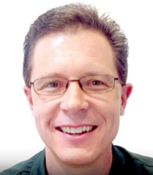


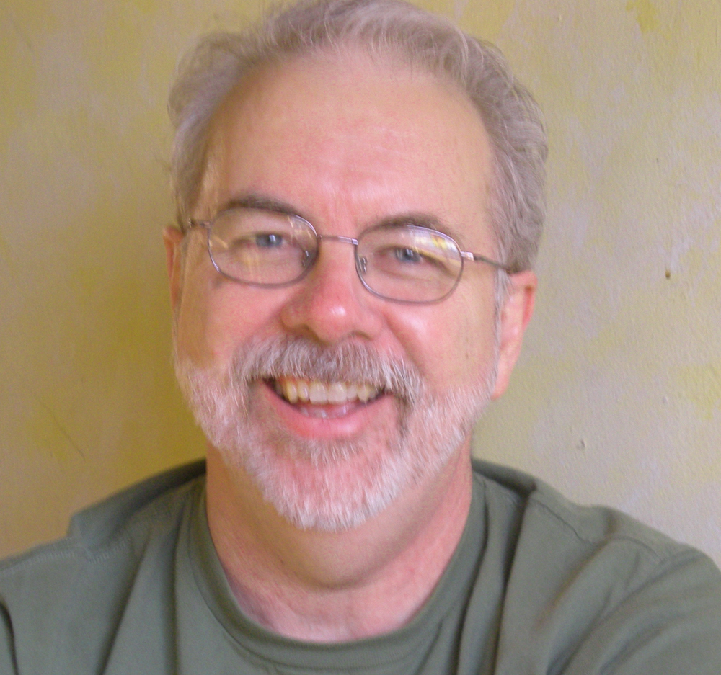
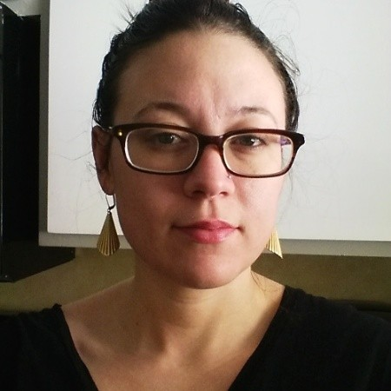
Carol Geyer Chief Development Officer
Your partners at OASIS
Carol Geyer Chief Development Officer
Guy Martin Executive Director
Jamie Clark General Counsel
Scott McGrath COO
Chet Ensign Chief Technical Community Steward
Jory Burson Open Projects Staff & Open Sourcerer
Notes:
You will have direct access to the OASIS executive and technical management team:
carol.geyer@oasis-open.org, based in Sarasota, Florida
guy.martin@oasis-open.org, based in Oregon
jamie.clark@oasis-open.org, based in Los Angeles
scott.mcgrath@oasis-open.org, based in Boston
chet.ensign@oasis-open.org, based in New York
jory.burson@oasis-open.org, based in Boston
OASIS also has staff in Washington, DC, Geneva, and Amsterdam.
We look forward to our next conversation.

